Slide 1
Build Self-Driving Car architecture with Robot Operating System
Alexey Sas – .NET Architect
Oleg Karasik – R&D Engineer

Slide 2
What is ROS?
ROS (the Robot Operating System) is collection of software frameworks for robot software development.
Plumbing - messaging infrastructure designed to support the quick and easy construction of distributed computing systems.
Tools - configuring, starting, debugging, visualizing, logging, testing
Capabilities - libraries that implement useful functionality, with a focus on mobility, manipulation, and perception
Ecosystem - supported and improved by a large community, with a strong focus on integration and documentation
https://answers.ros.org/question/12230/what-is-ros-exactly-middleware-framework-operating-system/#18055

Slide 3
Why ROS?
Open-source
Hardware abstraction of device drivers
Applicable to all kind of robotic systems
Communication via message passing
Encourage to write well-designed reusable components to dramatically reduce development time
Build and package management tools
Tools for visualization, simulation, analysis
Powerful software libraries including state of the art algorithms for perception, localization and control.

Slide 4
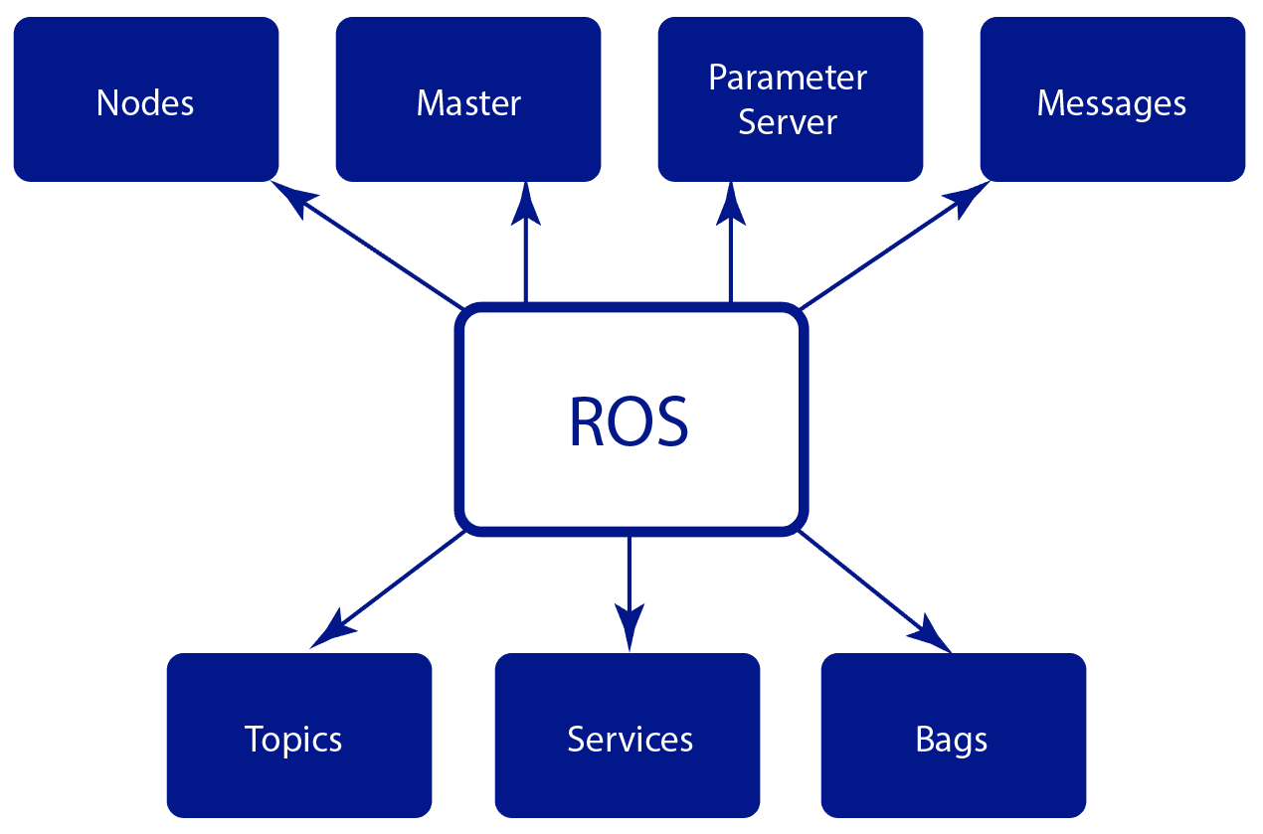
ROS Components

Slide 5
ROS Components
Nodes - process that perform computation (usually written with client libraries roscpp, rospy)
Master - provides name registration and lookup to the rest of the nodes
Parameter Server - allows to keep the data to be stored in a central location
Messages - nodes communicate with each other using messages. Simple data structure
Topics - named buses to transfer ROS messages between nodes using publish/subscribe model
Services - allows node communications using request/response pattern
Bags - bags are a format for saving and playing back ROS message data

Slide 6
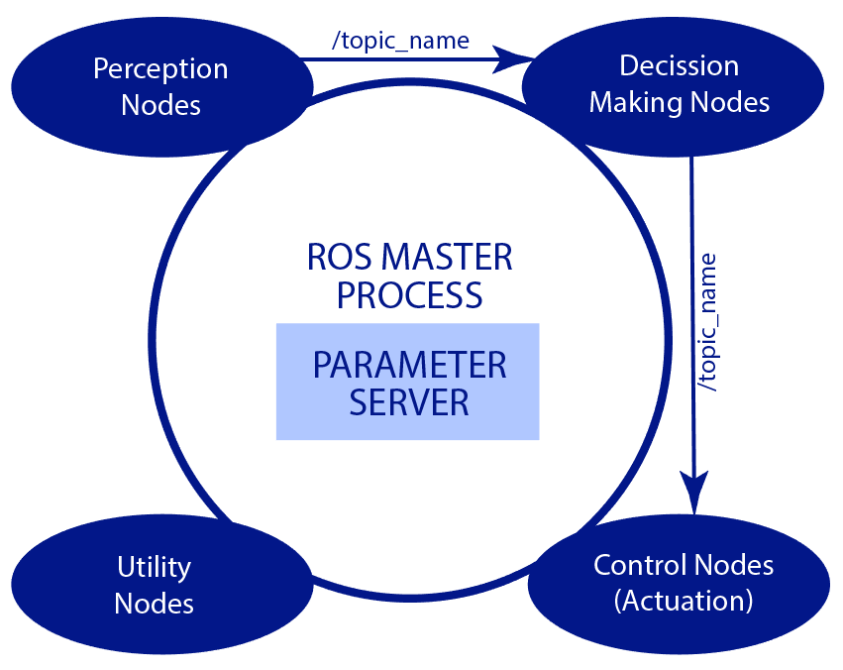
Typical high-level architecture with ROS

Slide 7
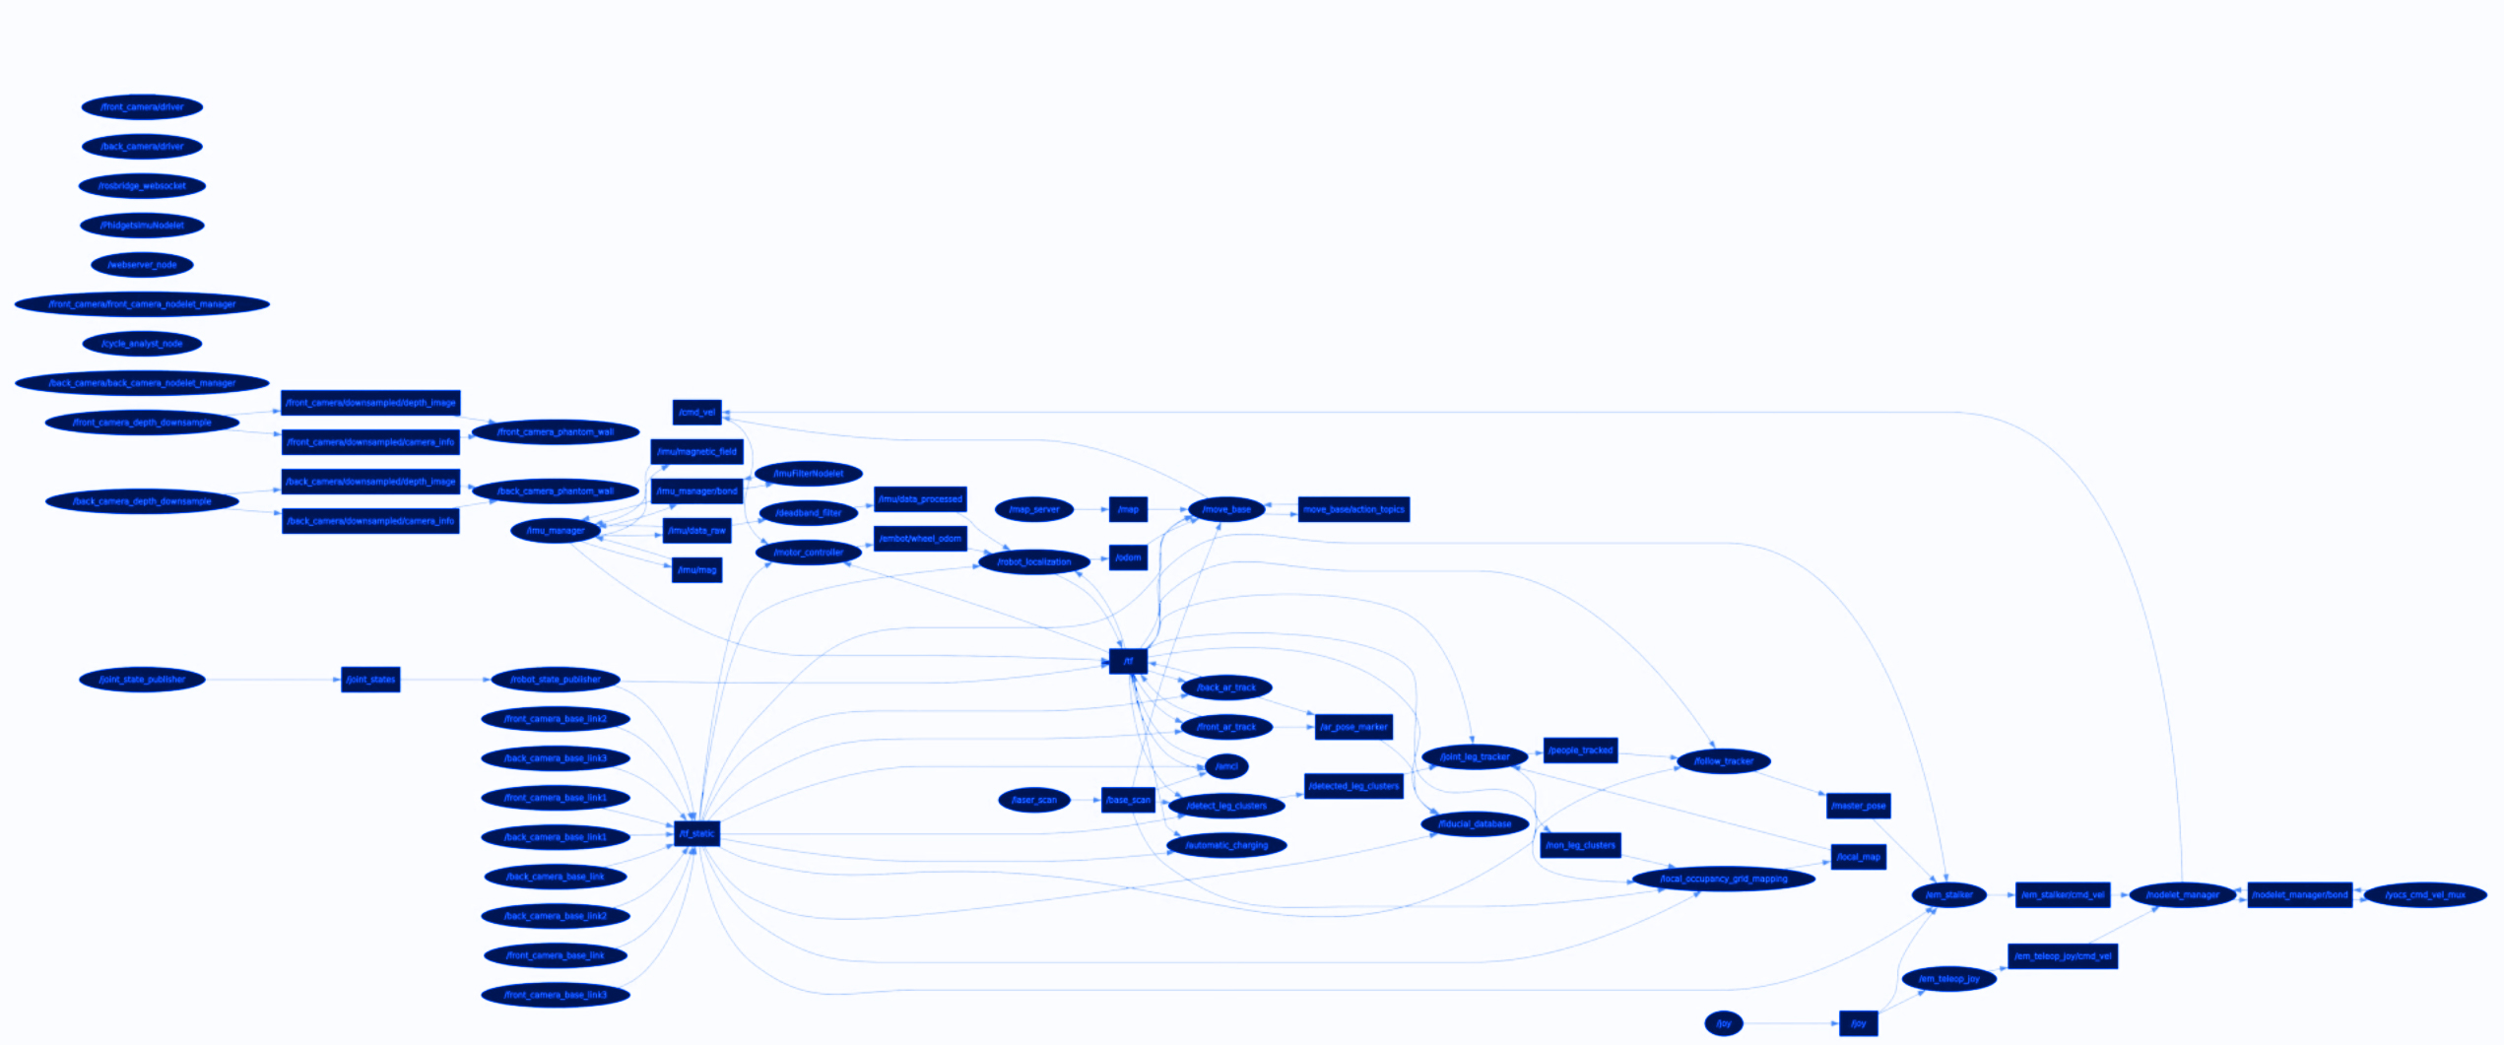
Architecture of simple robot with LIDAR and 4 wheels

Slide 8
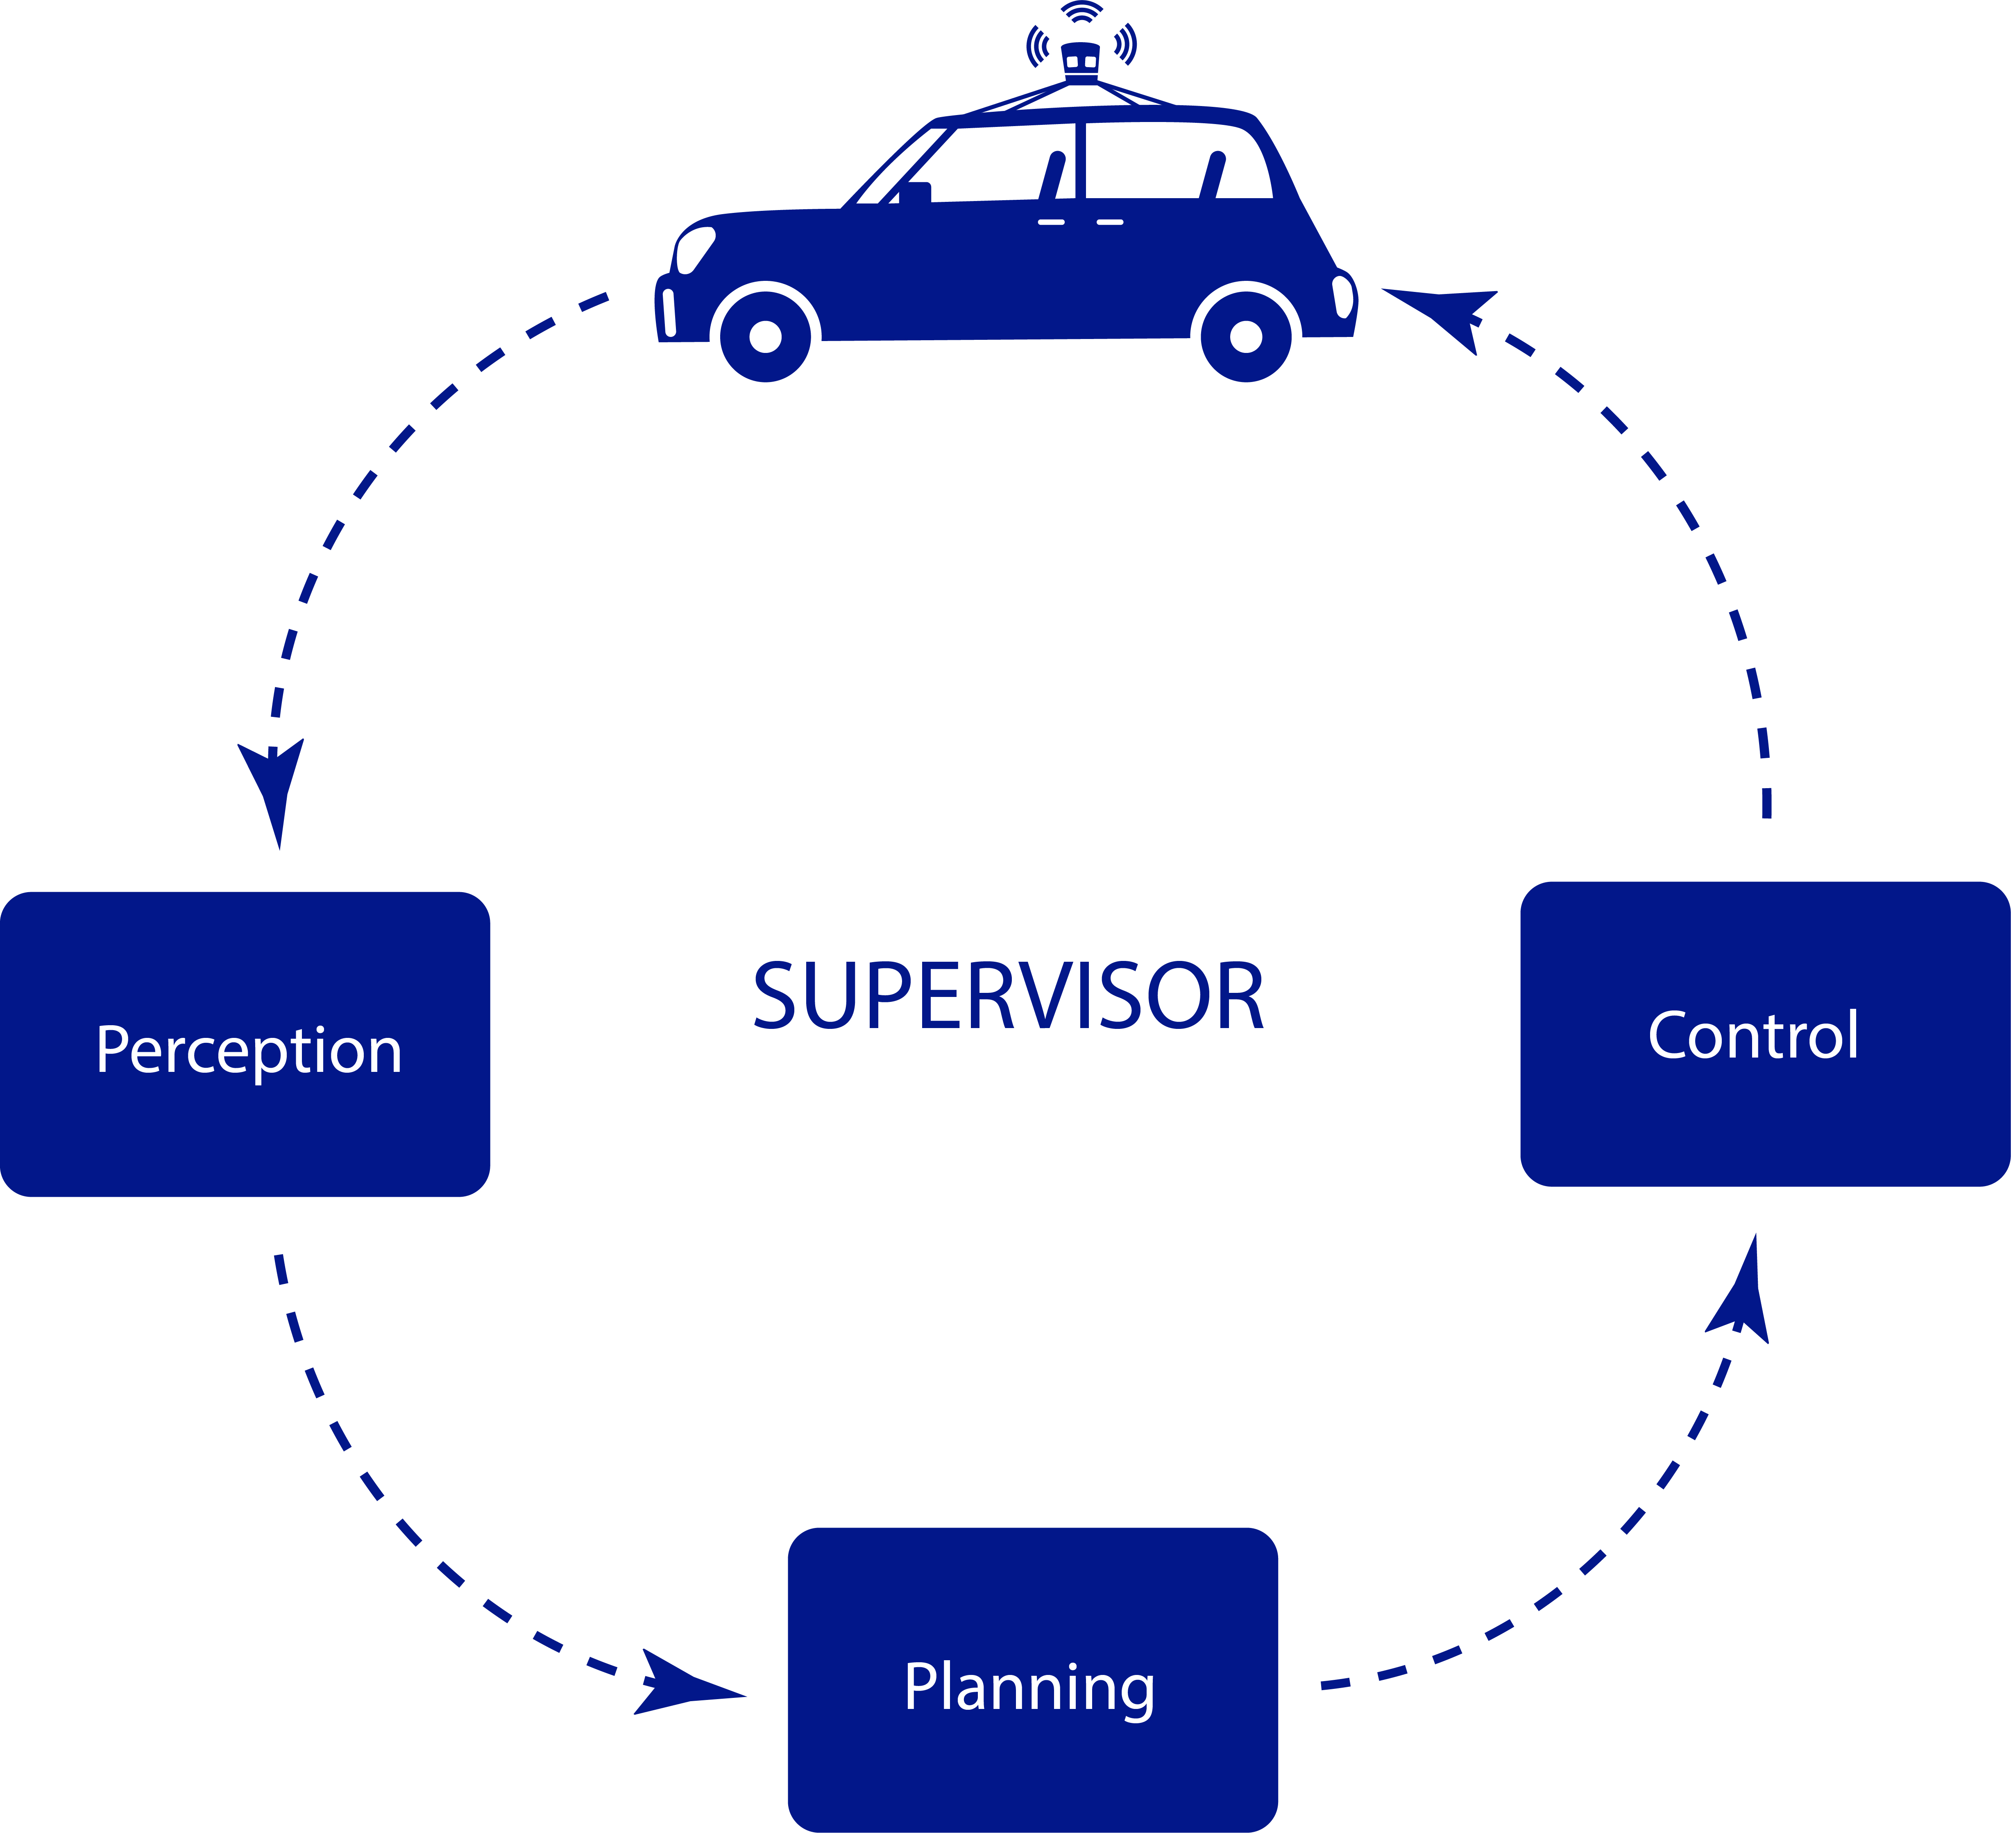
Self-driving car architecture

Slide 9
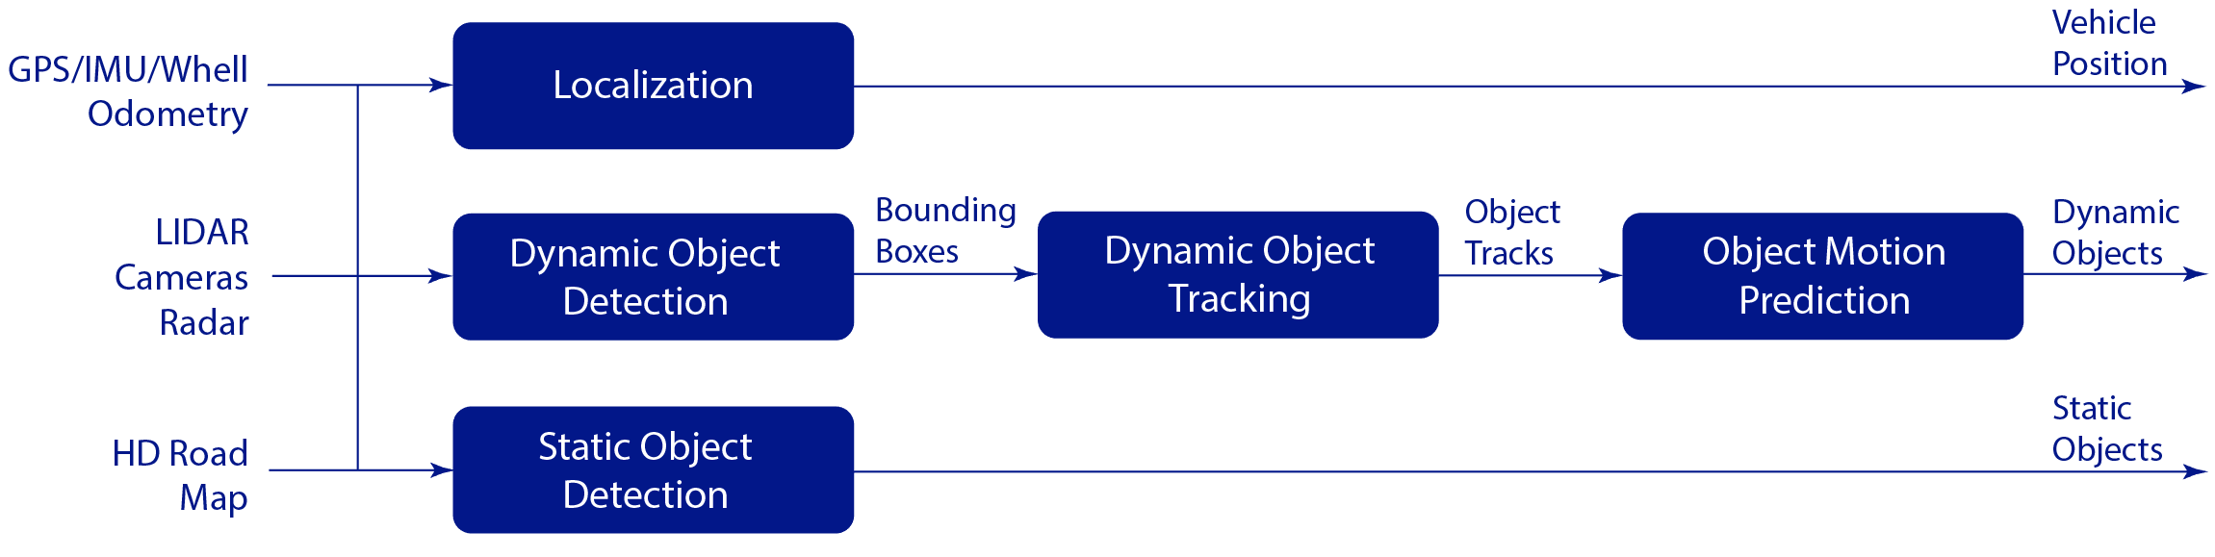
Self-driving car architecture: perception

Slide 10
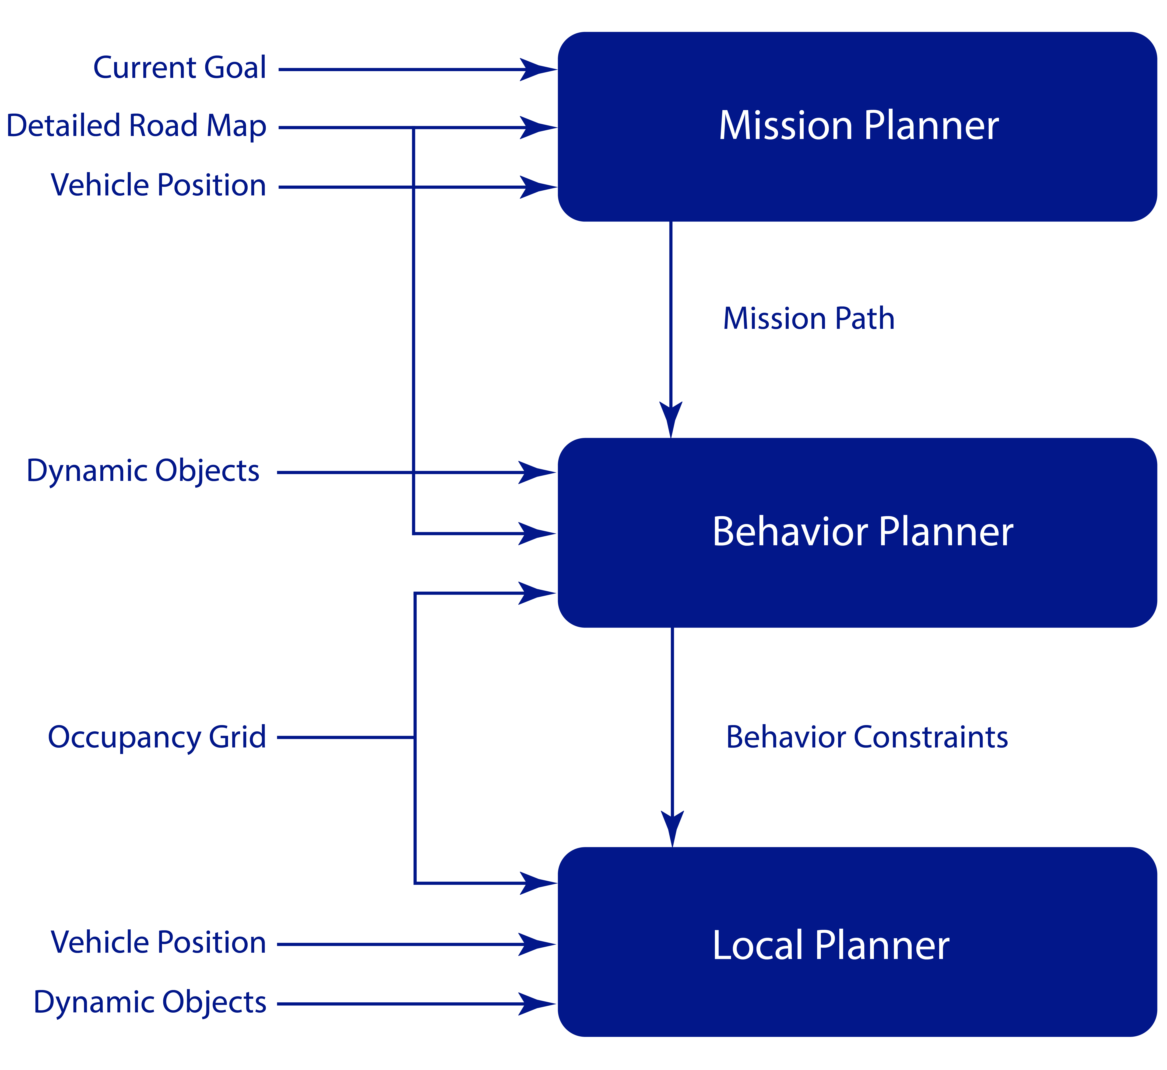
Self-driving car architecture: planning

Slide 11
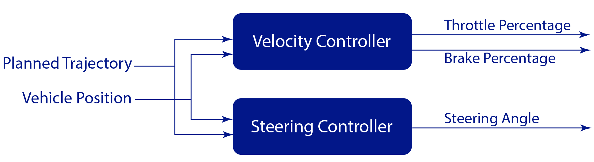
Self-driving car architecture: control

Slide 12
Building simple self-driving car architecture with CARLA simulator and ROS

Slide 13
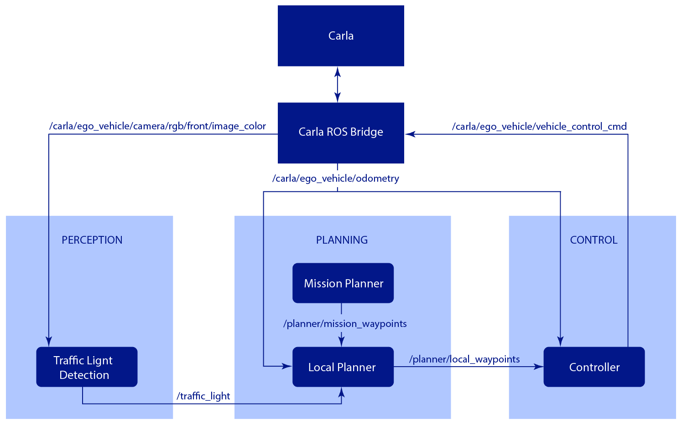
Simplified architecture with ROS

Slide 14
Setup ROS environment
Run CARLA Server
Run ROS bridge
Run CARLA Client to place car
Create new empty ROS package
Create test node to see camera images

Slide 15
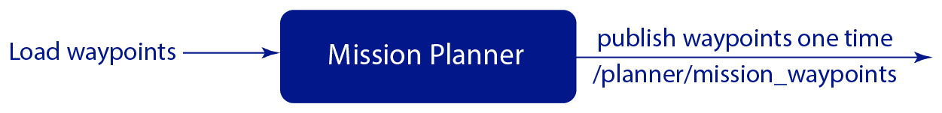
Mission planner node
Create new Python based ROS node
Define custom message types to support waypoints list
Load planned path from disk
Publish loaded waypoints to the /planner/mission_waypoints topic
Test and run node

Slide 16
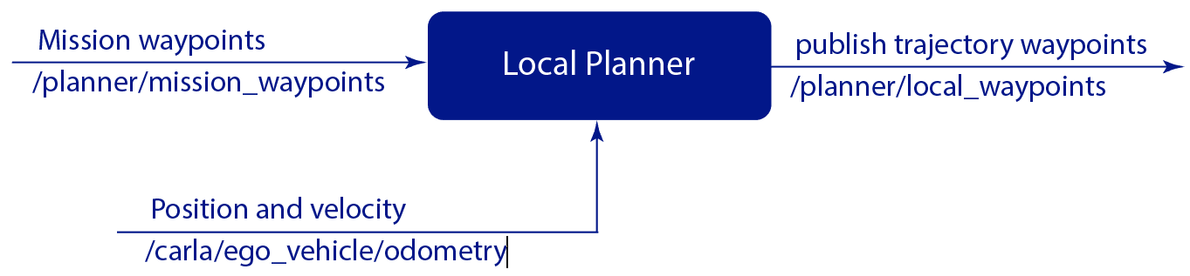
Local planner node
Create new python based ROS node
Create new message types to support trajectory waypoints
Subscribe to the /planner/mission_waypoints to get planned path
Subscribe to the /carla/ego_vehicle/odometry to get car position and velocity
Plan trajectory starting from current vehicle position
Set desired velocity for each trajectory endpoint
Publish planned trajectory to the /planner/local_waypoints

Slide 17
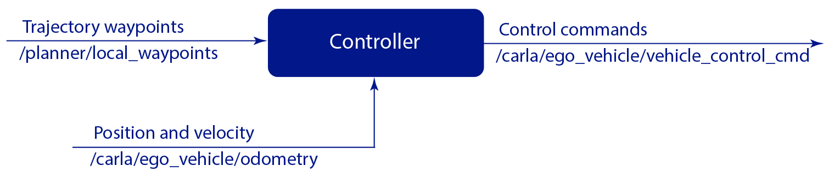
Controller node
Create new python based ROS node
Add new message type to support CARLA control commands
Subscribe to the /planner/local_waypoints to get next desired potions and velocity
Subscribe to the /carla/ego_vehicle/odometry to get current car position and velocity
Implement PID controller for longitudinal control
Implement Stanley controller for lateral control
Publish control commands to /carla/ego_vehicle/vehicle_control_cmd

Slide 18
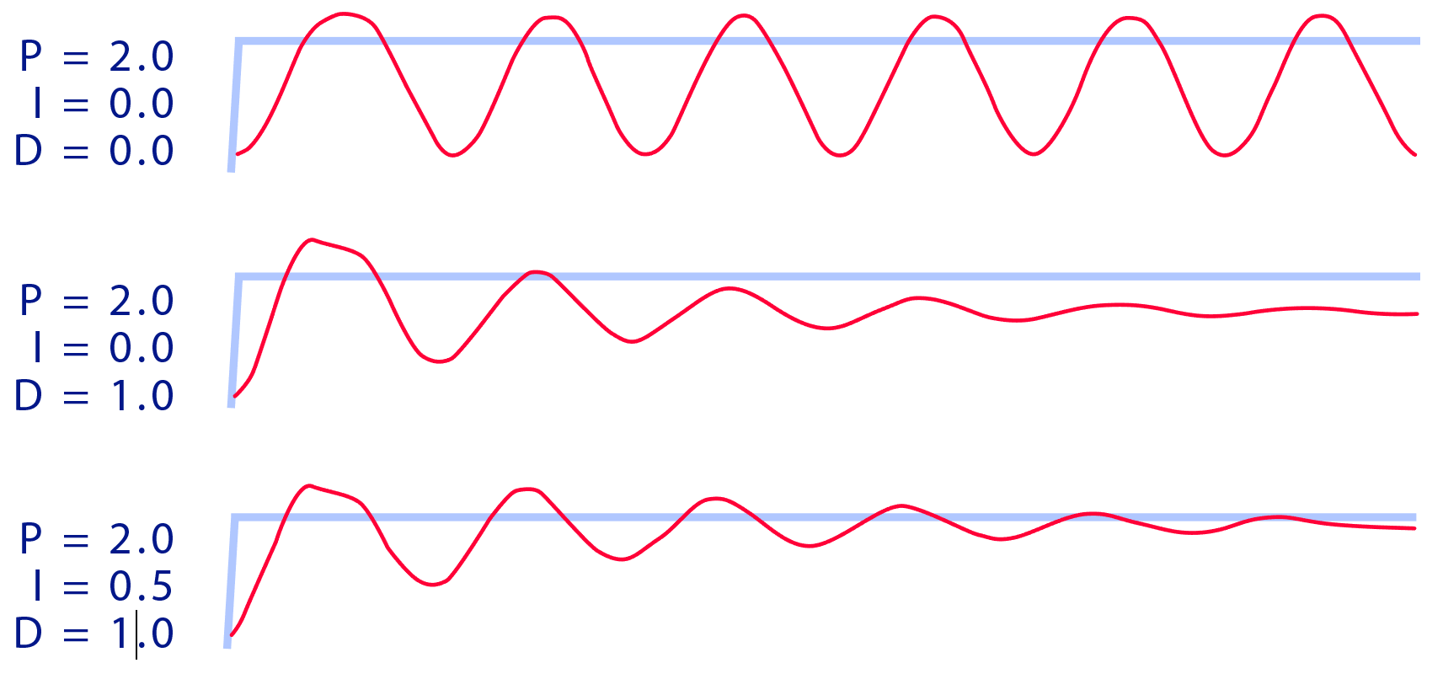
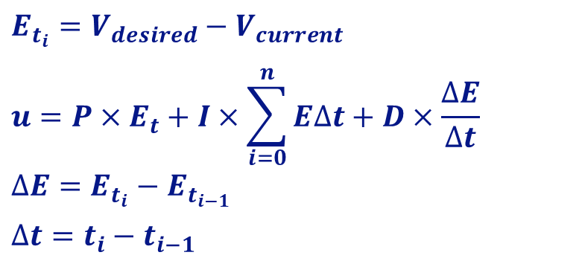
PID controller
$$E_{t_{i}}=V_{desired}−V_{current}$$
$$u=P×E_{t}+I×\sum_{i=0}^{n}{E∆t}+D×\frac{∆E}{∆t}$$
$$∆E=E_{t_{i}}−E_{t_{i−1}}$$
$$∆t=t_{i}−t_{i−1}$$

Slide 19
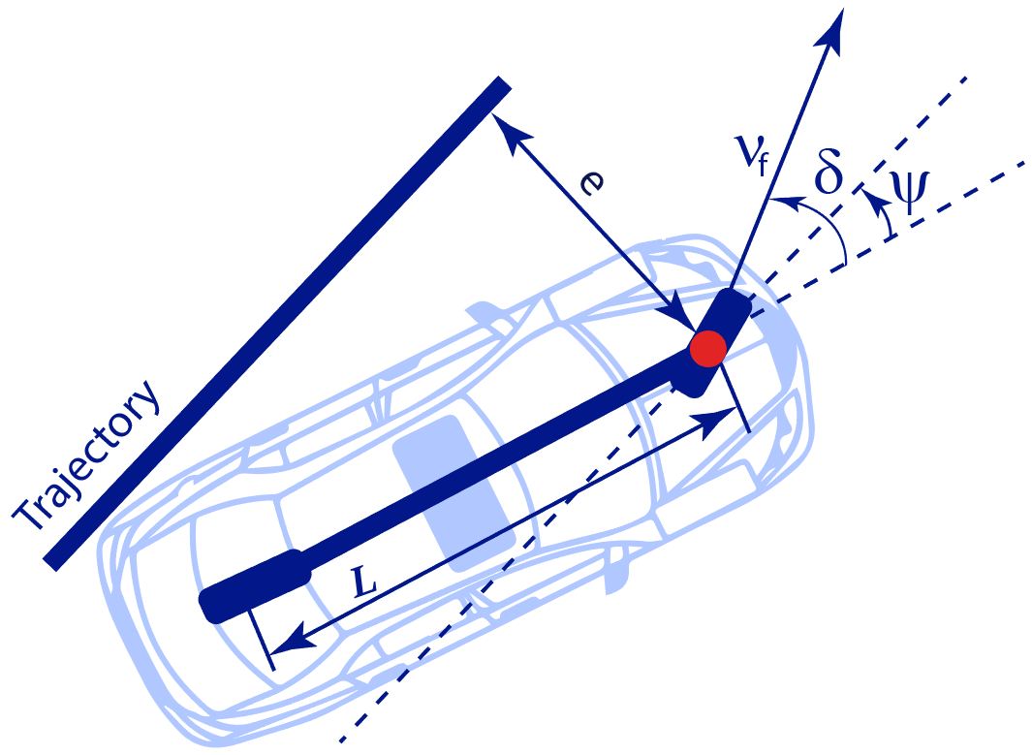

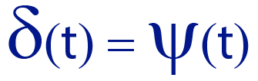
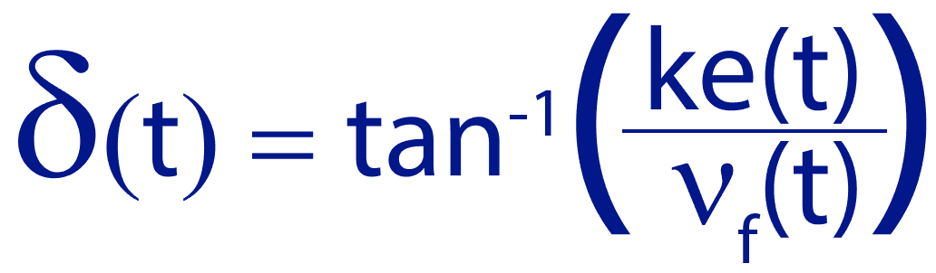
Stanley controller
Eliminate heading error
Eliminate CTE error e
Stanley Control Law:

Slide 20
Lets go!

